Slide 1
Making solar power affordable:
Using data to maximize cost efficiency
By Zachary Brown

Slide 2
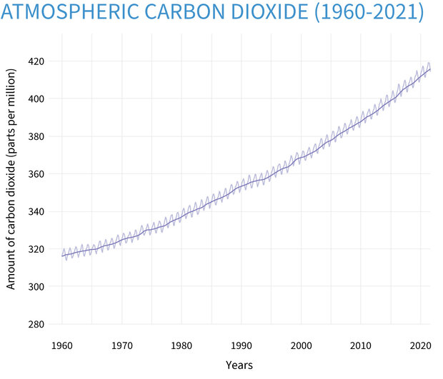
Carbon emissions over time
Source: climate.gov

Slide 3
Project goal
To provide recommendations to homeowners in Texas that will help maximize the cost efficiency of their solar panel installation
Notes:
The goal of this project is to provide recommendations to homeowners in Texas that will help maximize the cost efficiency of their solar panel installation, with the hope that maybe these recommendations can help more homeowners make that investment in our collective future.

Slide 4
How to make solar panels affordable
Purchase the largest configuration of solar panels that makes sense for the house
Design the solar panel installation with a relatively high inverter loading ratio
Identify and secure any rebate or grant available
Consider buying a solar panel model with lower conversion efficiency
Consider scheduling the installation for July or December
Notes:
In this project I have developed a model to help guide homeowners in designing their solar panel installation to be as cost-effective as possible. In order to get the most output for your dollar, it’s important to purchase the largest solar panel array that makes sense for the house and the customer’s budget

Slide 5
How to make solar panels affordable
Purchase the largest configuration of solar panels that makes sense for the house
Design the solar panel installation with a relatively high inverter loading ratio
Identify and secure any rebate or grant available
Consider buying a solar panel model with lower conversion efficiency
Consider scheduling the installation for July or December
Notes:
The installation should have a high inverter loading ratio - I’ll explain that concept later in the presentation

Slide 6
How to make solar panels affordable
Purchase the largest configuration of solar panels that makes sense for the house
Design the solar panel installation with a relatively high inverter loading ratio
Identify and secure any rebate or grant available
Consider buying a solar panel model with lower conversion efficiency
Consider scheduling the installation for July or December
Notes:
Needless to say, any rebate or grant that’s available will help reduce the price of an installation

Slide 7
How to make solar panels affordable
Purchase the largest configuration of solar panels that makes sense for the house
Design the solar panel installation with a relatively high inverter loading ratio
Identify and secure any rebate or grant available
Consider buying a solar panel model with lower conversion efficiency
Consider scheduling the installation for July or December
Notes:
Solar panels with lower conversion efficiency are cheaper than those with high efficiency. If a customer is only concerned with the upfront costs, then lower efficiency will help keep the installation price down

Slide 8
How to make solar panels affordable
Purchase the largest configuration of solar panels that makes sense for the house
Design the solar panel installation with a relatively high inverter loading ratio
Identify and secure any rebate or grant available
Consider buying a solar panel model with lower conversion efficiency
Consider scheduling the installation for July or December
Notes:
Finally, it also helps to schedule installations in July or December. As we walk through the project I’ll show where the data came from, how it was analyzed, and get in to the details of the model.

Slide 9
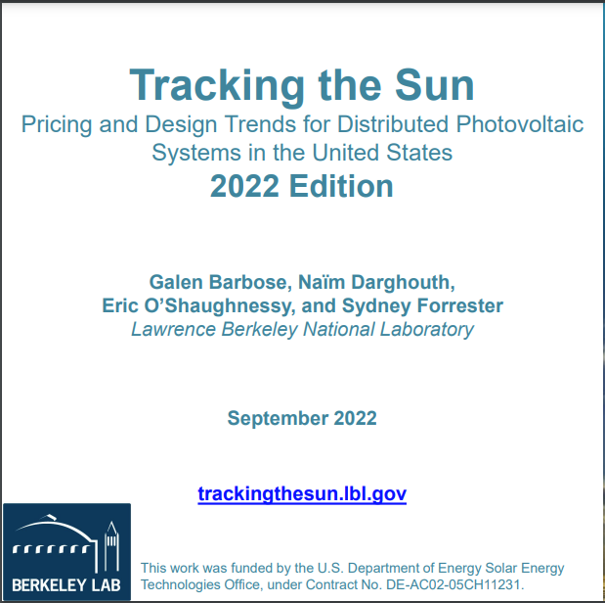
The data
Residential installations only
2020/2021 installations
26 states included in the data, all were used in this analysis
Notes:
The data used for this project was collected by the Lawrence Berkeley National Laboratory through their Tracking the Sun project. Since the goal of the project is to help guide homeowners I restricted the data to only residential installations.

Slide 10
The data
Residential installations only
2020/2021 installations
26 states included in the data, all were used in this analysis
Notes:
I also wanted to ensure that I was using the most up-to-date information, so I used only 2020 and 2021 installation data

Slide 11
The data
Residential installations only
2020/2021 installations
26 states included in the data, all were used in this analysis
Notes:
And I used all of the 26 states included in the LBNL dataset. After filtering these values I was left with roughly 200,000 entries and 80 features to work with

Slide 12
Cost Efficiency
Relevant fields:
Total installed price
System size (DC)
Rebate or grant
Cost efficiency metric:
Price per KW
total installed price - rebate or grant
Price per KW =
system size (DC)
Notes:
The first step in this project was to create the key metric that would be modeled. The cost efficiency metric was price per KW, which was calculated as total installed price minus any rebates or grants, divided by the system size. After creating this field, total installed price was dropped from the data because it’s unlikely that the customer has direct control over that value outside of shopping around, and keeping it in would likely be the primary feature used by any model.

Slide 13
Feature Engineering
Dummy Variables
Train-Test Split
Missing Value Imputation
Feature Scaling
Feature Selection
Categorical features with more than 30 instances dummied
Dataset split into 75% training set and 25% test set
Simple imputer using most common value fit on train set, applied to train and test sets
Standard scaler fit to train data, applied to train and test sets
Select 400 best features with f-regression trained on train, applied to train and test
1
2
3
4
5
Notes:
Next I began feature engineering by creating dummy variables for any values in categorical features with more than 30 occurrences. Any values that appeared fewer than 30 times was dropped, and the original columns were dropped to avoid collinearity

Slide 14
Feature Engineering
Dummy Variables
Train-Test Split
Missing Value Imputation
Feature Scaling
Feature Selection
Categorical features with more than 30 instances dummied
Dataset split into 75% training set and 25% test set
Simple imputer using most common value fit on train set, applied to train and test sets
Standard scaler fit to train data, applied to train and test sets
Select 400 best features with f-regression trained on train, applied to train and test
1
2
3
4
5
Notes:
Next I began feature engineering by creating dummy variables for any values in categorical features with more than 30 occurrences. Any values that appeared fewer than 30 times was dropped, and the original columns were dropped to avoid collinearity

Slide 15
Feature Engineering
Dummy Variables
Train-Test Split
Missing Value Imputation
Feature Scaling
Feature Selection
Categorical features with more than 30 instances dummied
Dataset split into 75% training set and 25% test set
Simple imputer using most common value fit on train set, applied to train and test sets
Standard scaler fit to train data, applied to train and test sets
Select 400 best features with f-regression trained on train, applied to train and test
1
2
3
4
5
Notes:
Next I began feature engineering by creating dummy variables for any values in categorical features with more than 30 occurrences. Any values that appeared fewer than 30 times was dropped, and the original columns were dropped to avoid collinearity

Slide 16
Feature Engineering
Dummy Variables
Train-Test Split
Missing Value Imputation
Feature Scaling
Feature Selection
Categorical features with more than 30 instances dummied
Dataset split into 75% training set and 25% test set
Simple imputer using most common value fit on train set, applied to train and test sets
Standard scaler fit to train data, applied to train and test sets
Select 400 best features with f-regression trained on train, applied to train and test
1
2
3
4
5
Notes:
Next I began feature engineering by creating dummy variables for any values in categorical features with more than 30 occurrences. Any values that appeared fewer than 30 times was dropped, and the original columns were dropped to avoid collinearity

Slide 17
Feature Engineering
Dummy Variables
Train-Test Split
Missing Value Imputation
Feature Scaling
Feature Selection
Categorical features with more than 30 instances dummied
Dataset split into 75% training set and 25% test set
Simple imputer using most common value fit on train set, applied to train and test sets
Standard scaler fit to train data, applied to train and test sets
Select 400 best features with f-regression trained on train, applied to train and test
1
2
3
4
5
Notes:
Next I began feature engineering by creating dummy variables for any values in categorical features with more than 30 occurrences. Any values that appeared fewer than 30 times was dropped, and the original columns were dropped to avoid collinearity

Slide 18
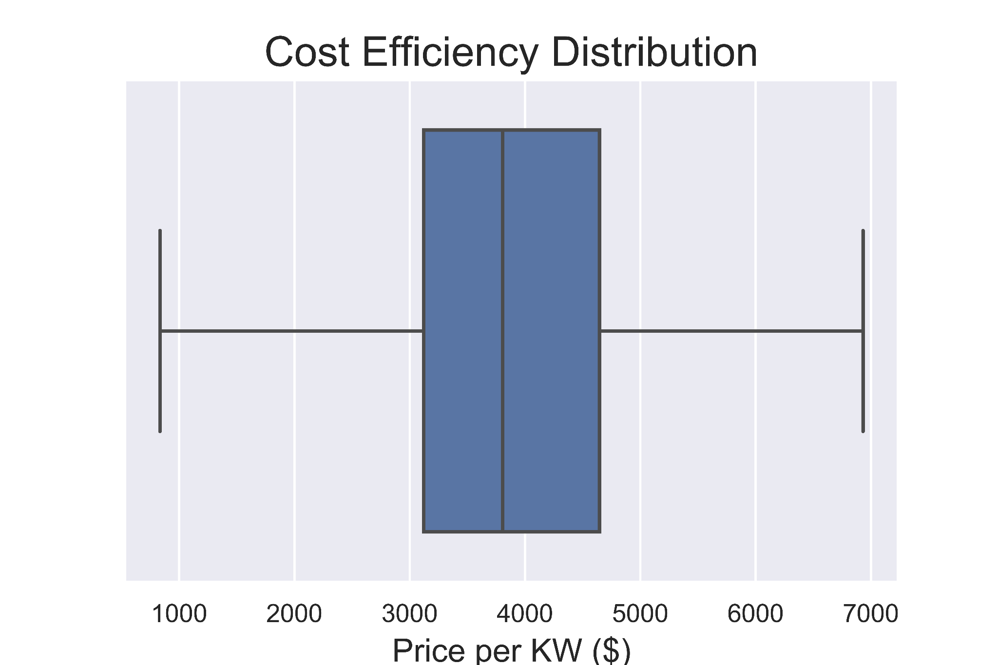
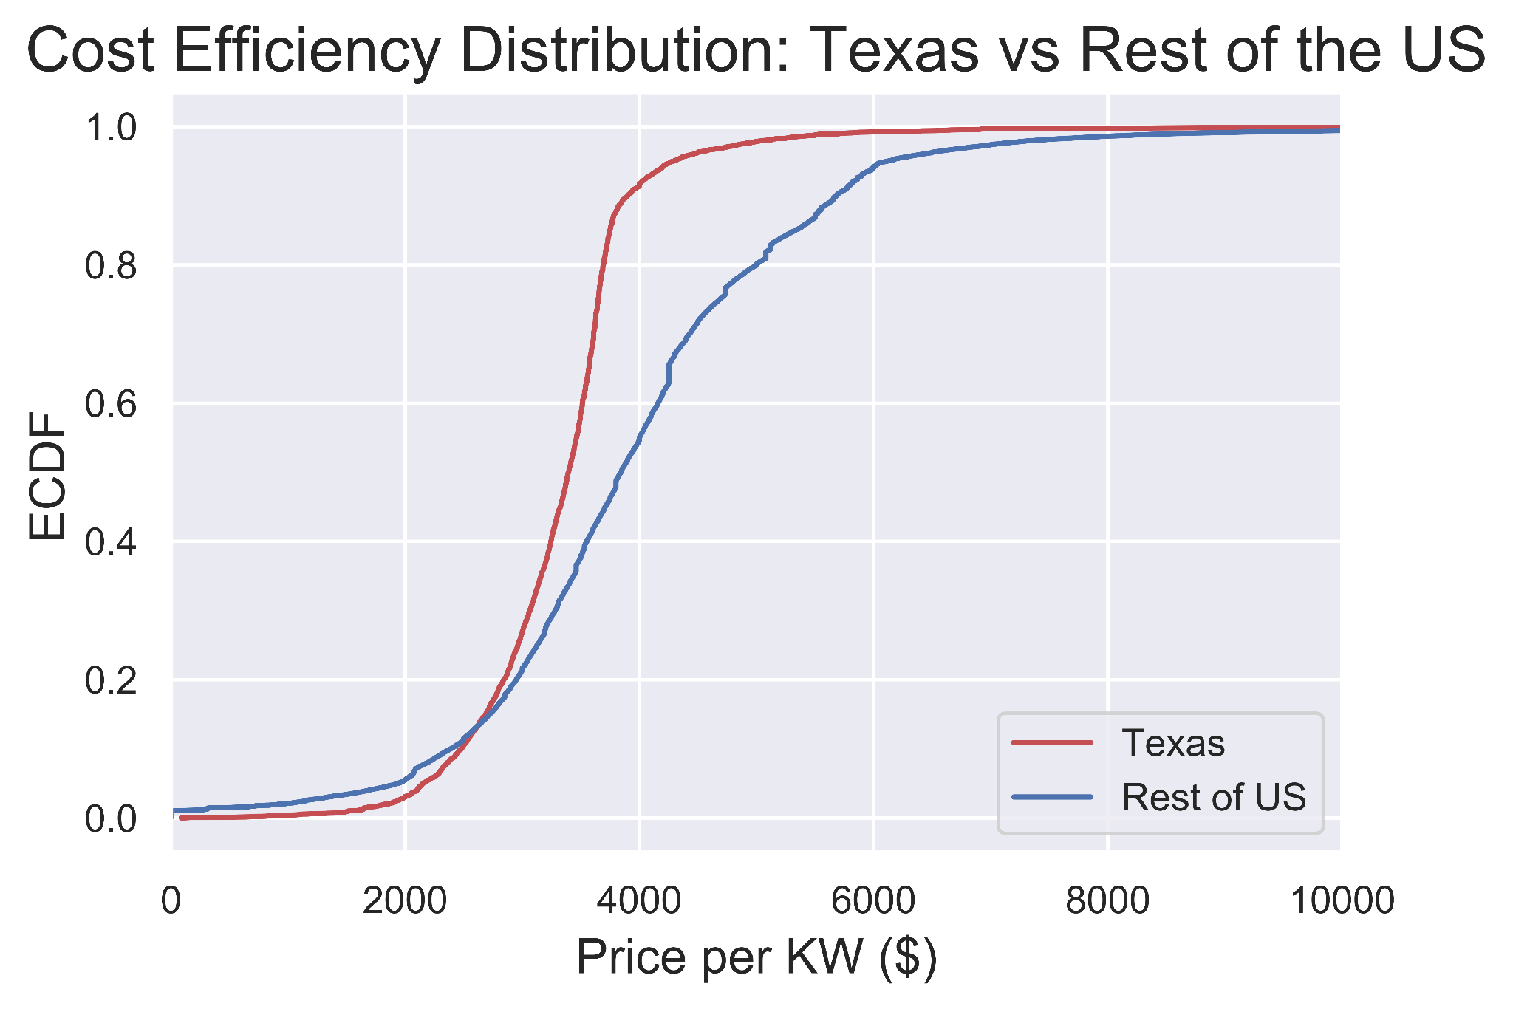
Data Analysis
Notes:
In addition to preparing the data for modeling, I also explored it for trends and to get a better understanding of the various features. I began by plotting the distribution of price per KW to get an idea of the range of values, and then I took a look at the distribution for Texas versus the rest of the US. As you can see, a resident in Texas can expect to most likely pay less per KW for their solar panel installation than people in other states.

Slide 19
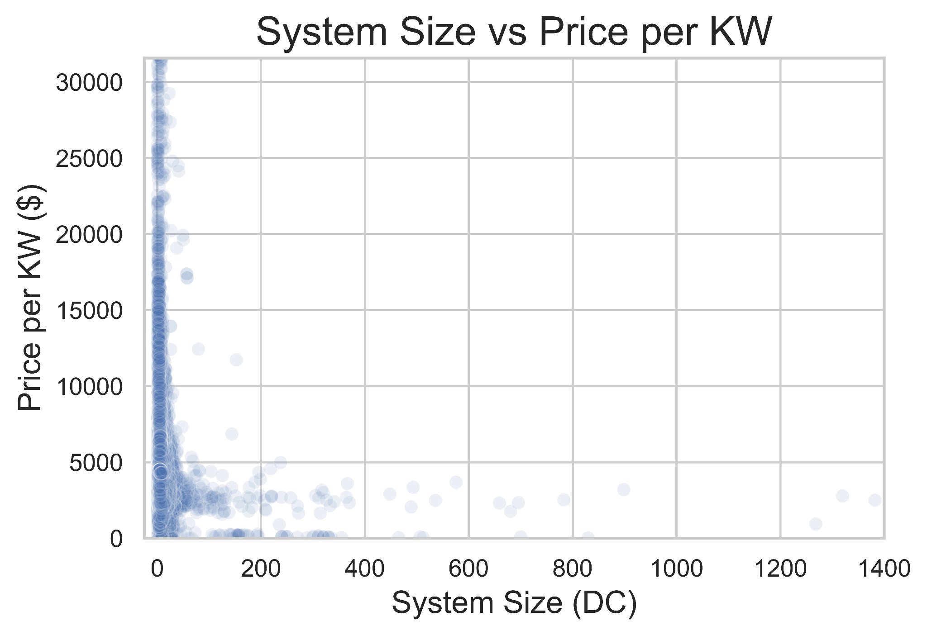
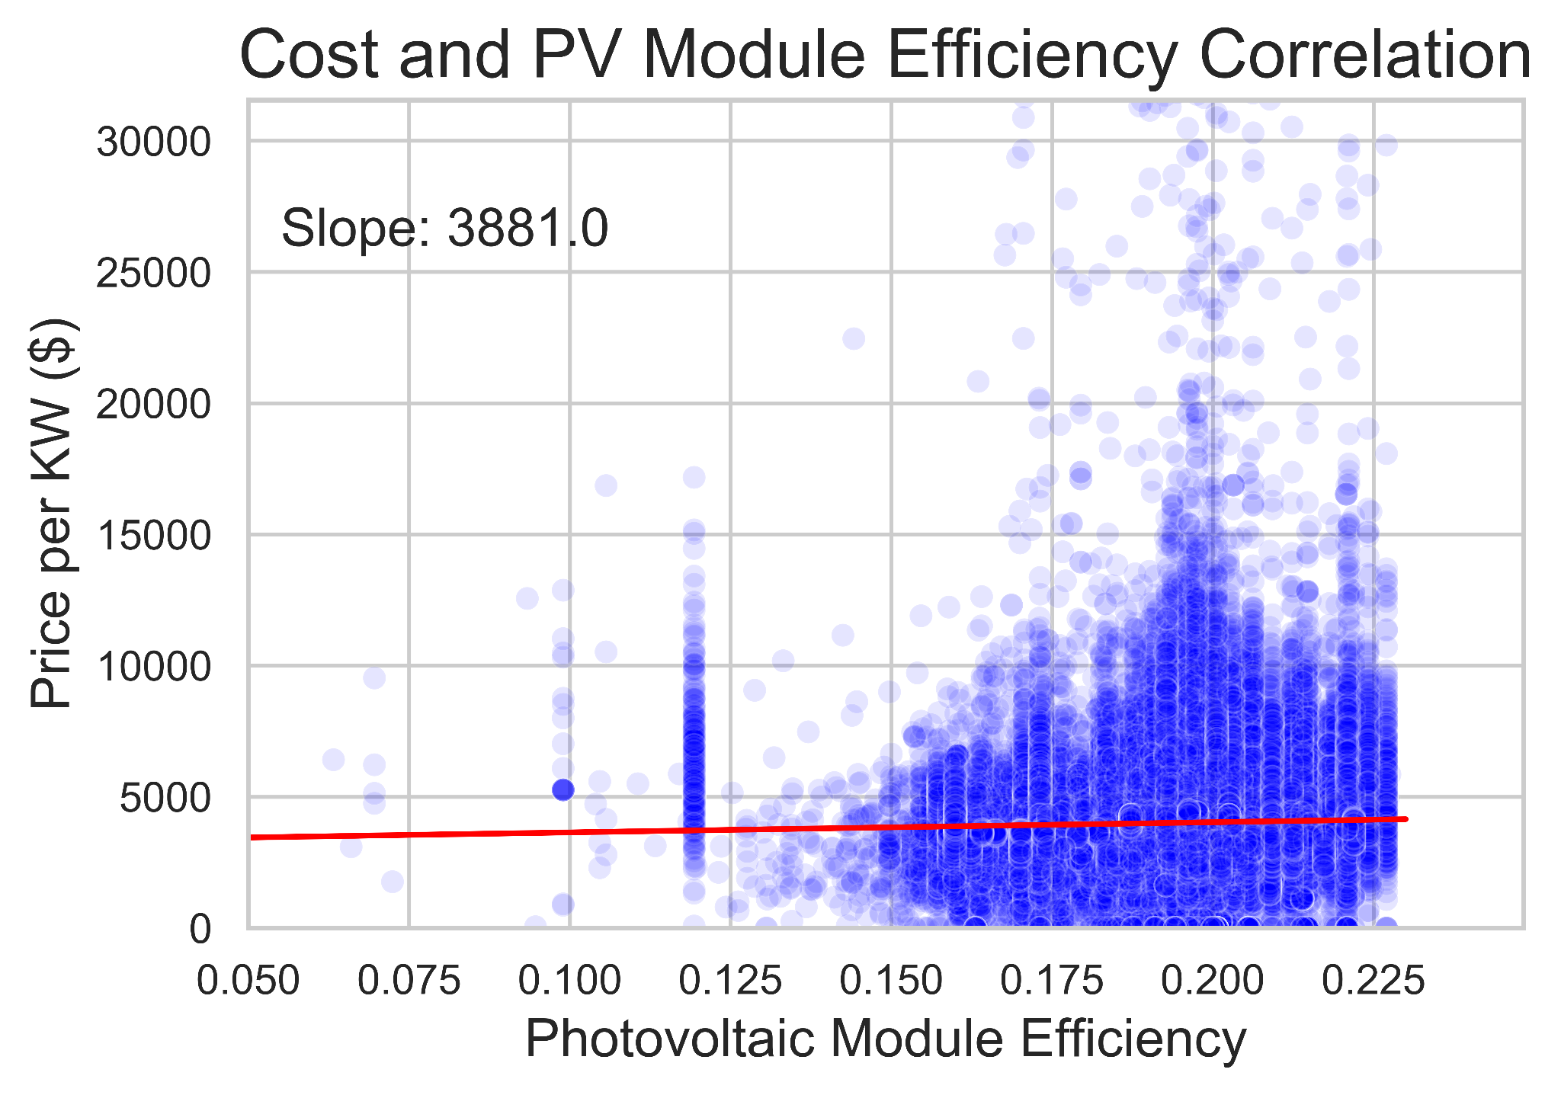
Solar Panel Features
Notes:
I dug into some features more deeply, such as system size, and solar panel efficiency, and as you can see, cost efficiency improves as system size increases, however, higher efficiency panels generally cost more than less efficient models.

Slide 20
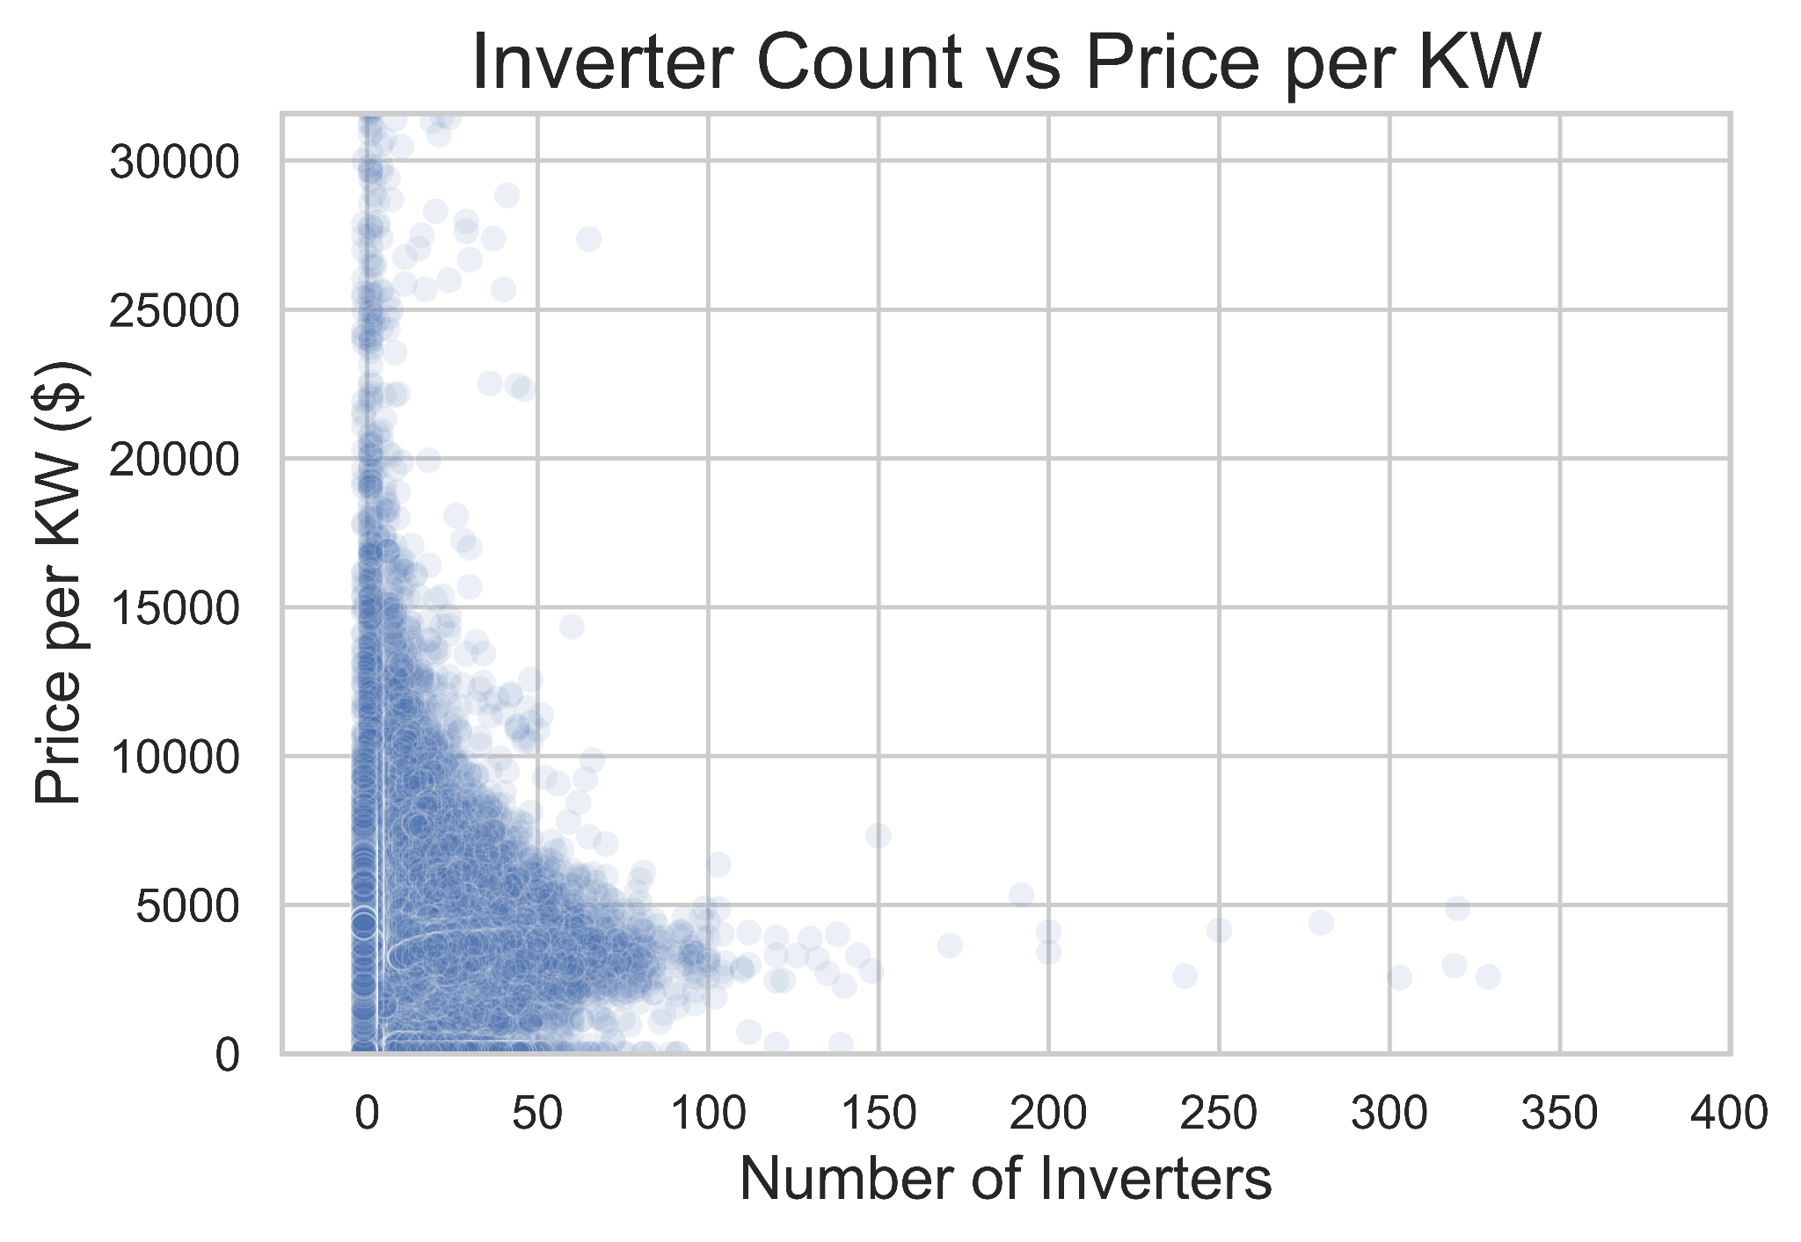
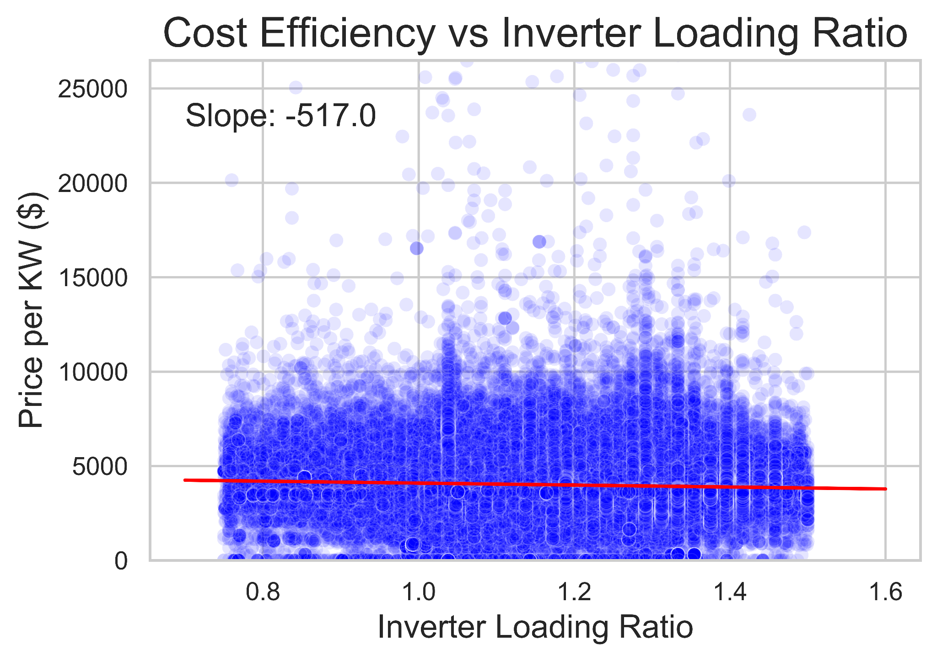
Inverter Features
Notes:
Taking a look at inverters, we see a similar price per unit decrease with increasing volume, and we see that as inverter loading ratio increases the cost efficiency improves as well. These show up again later in the presentation so I’ll explain more in a few minutes.

Slide 21
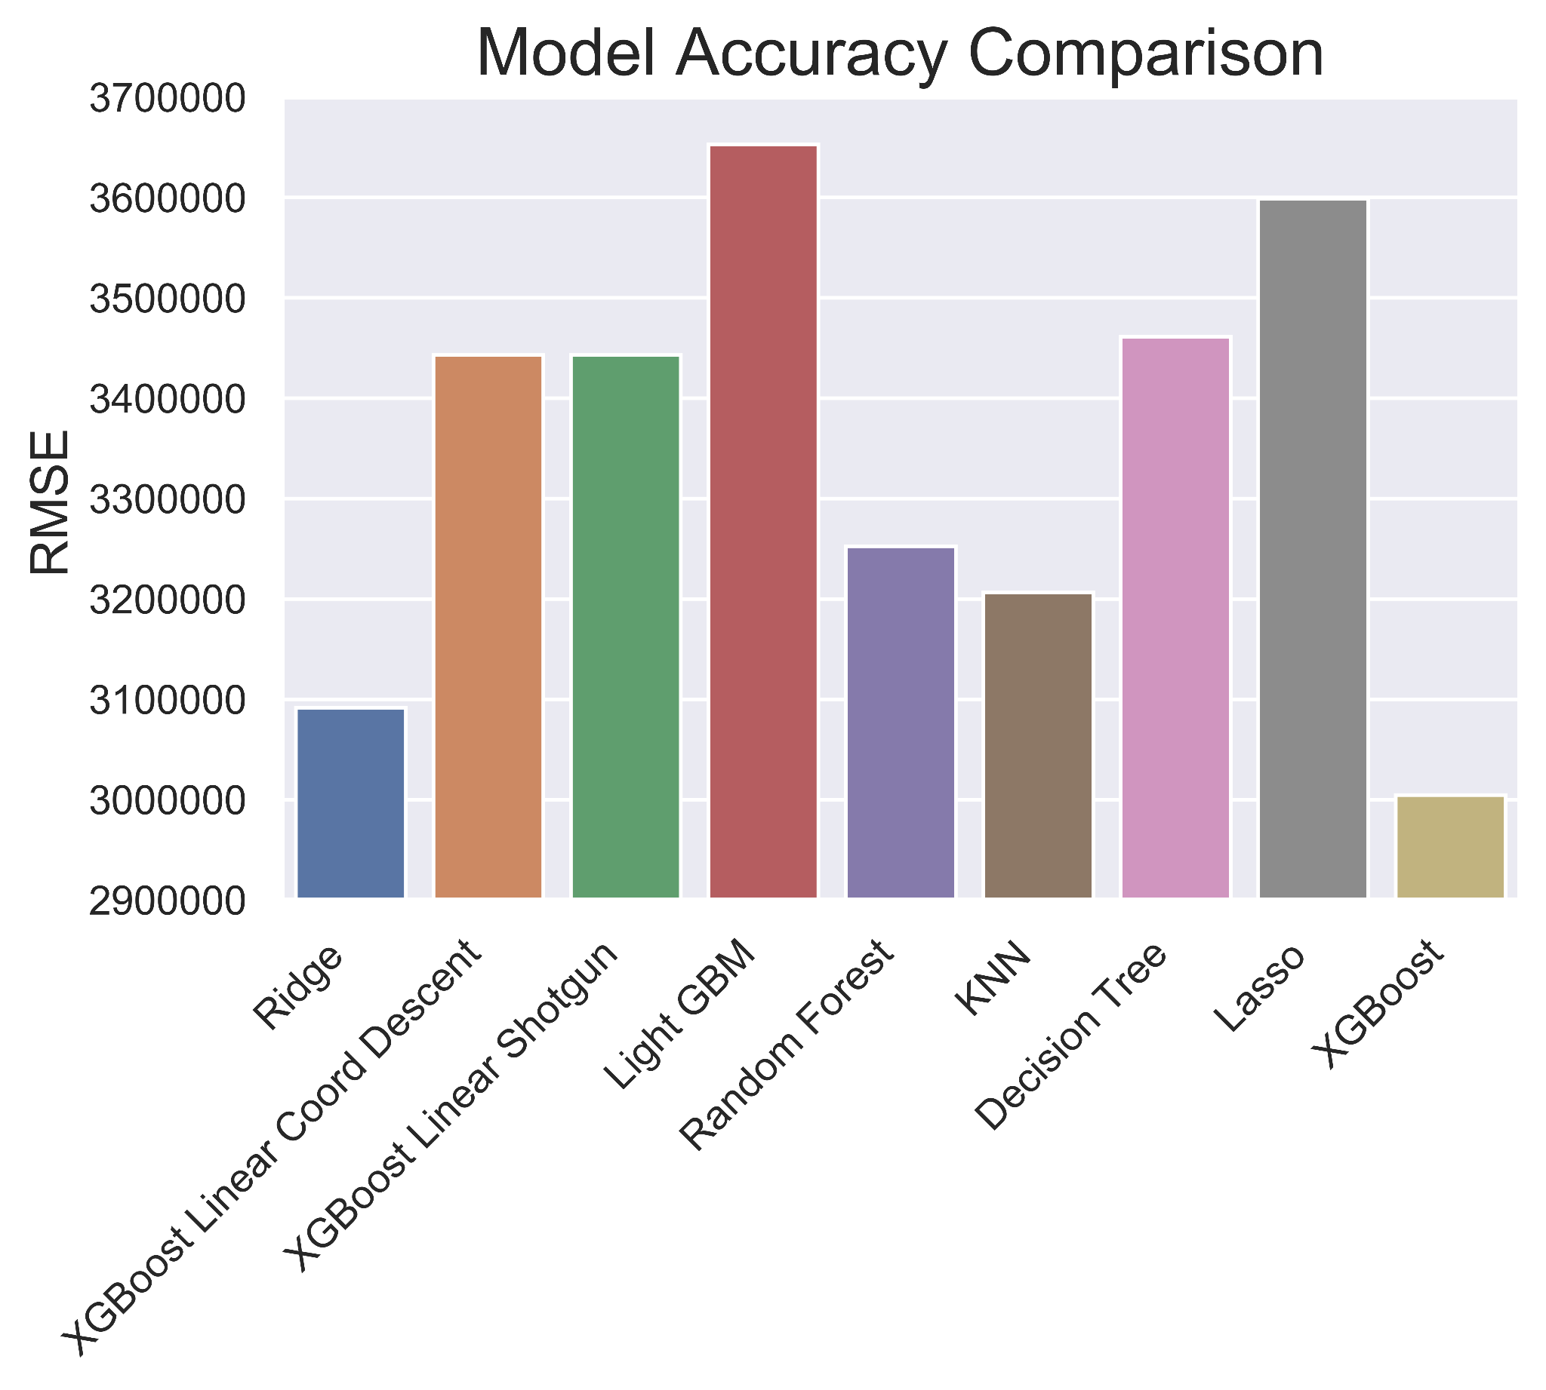
Initial Model Screening
Hyperparameter tuned models on 10% train set
Retrained on 80% of data with set hyperparameters
Tested on remaining 20% of dataset
Notes:
Once the data was prepared, I screened a wide array of regression models by tuning hyperparameters on 10% train sets. I then held these hyperparameters and trained the models on 80% of the data, testing them on the remaining 20%

Slide 22
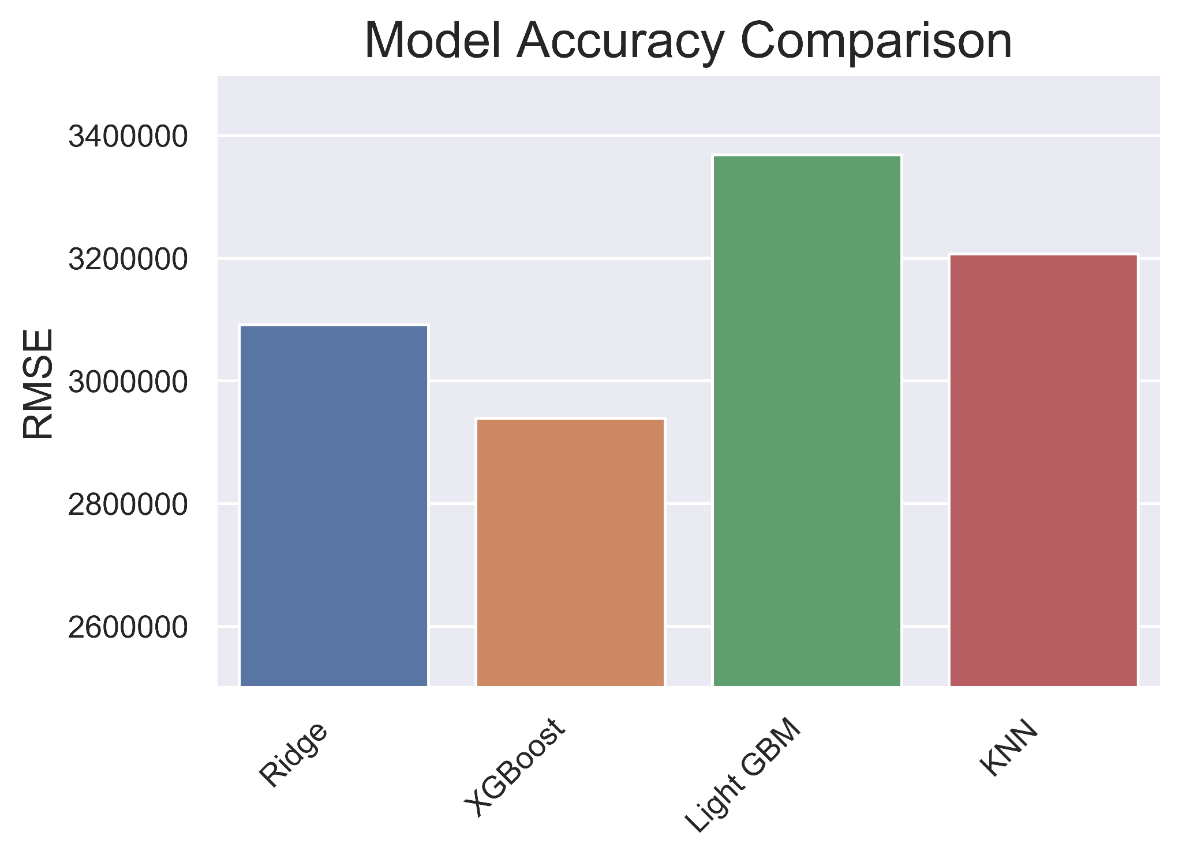
Further Tuning
Four models hyperparameter tuned with 80% of the data for training
Two of four hyperparameters locked for XGBoost and Light GBM
XGBoost had the best performance and was used for the remainder of the project
Notes:
After narrowing the models down to just ridge, XGBoost, light GBM, and KNN, the models were hyperparameter tuned again, this time with 80% of the data available for training. Prior to this tuning, the prior hyperparameter tuning results were examined to identify if any could be locked. Two of the four hyperparameters in XGBoost and light GBM seemed to have very little variation through the prior tuning, so they were held constant at this stage.

Slide 23
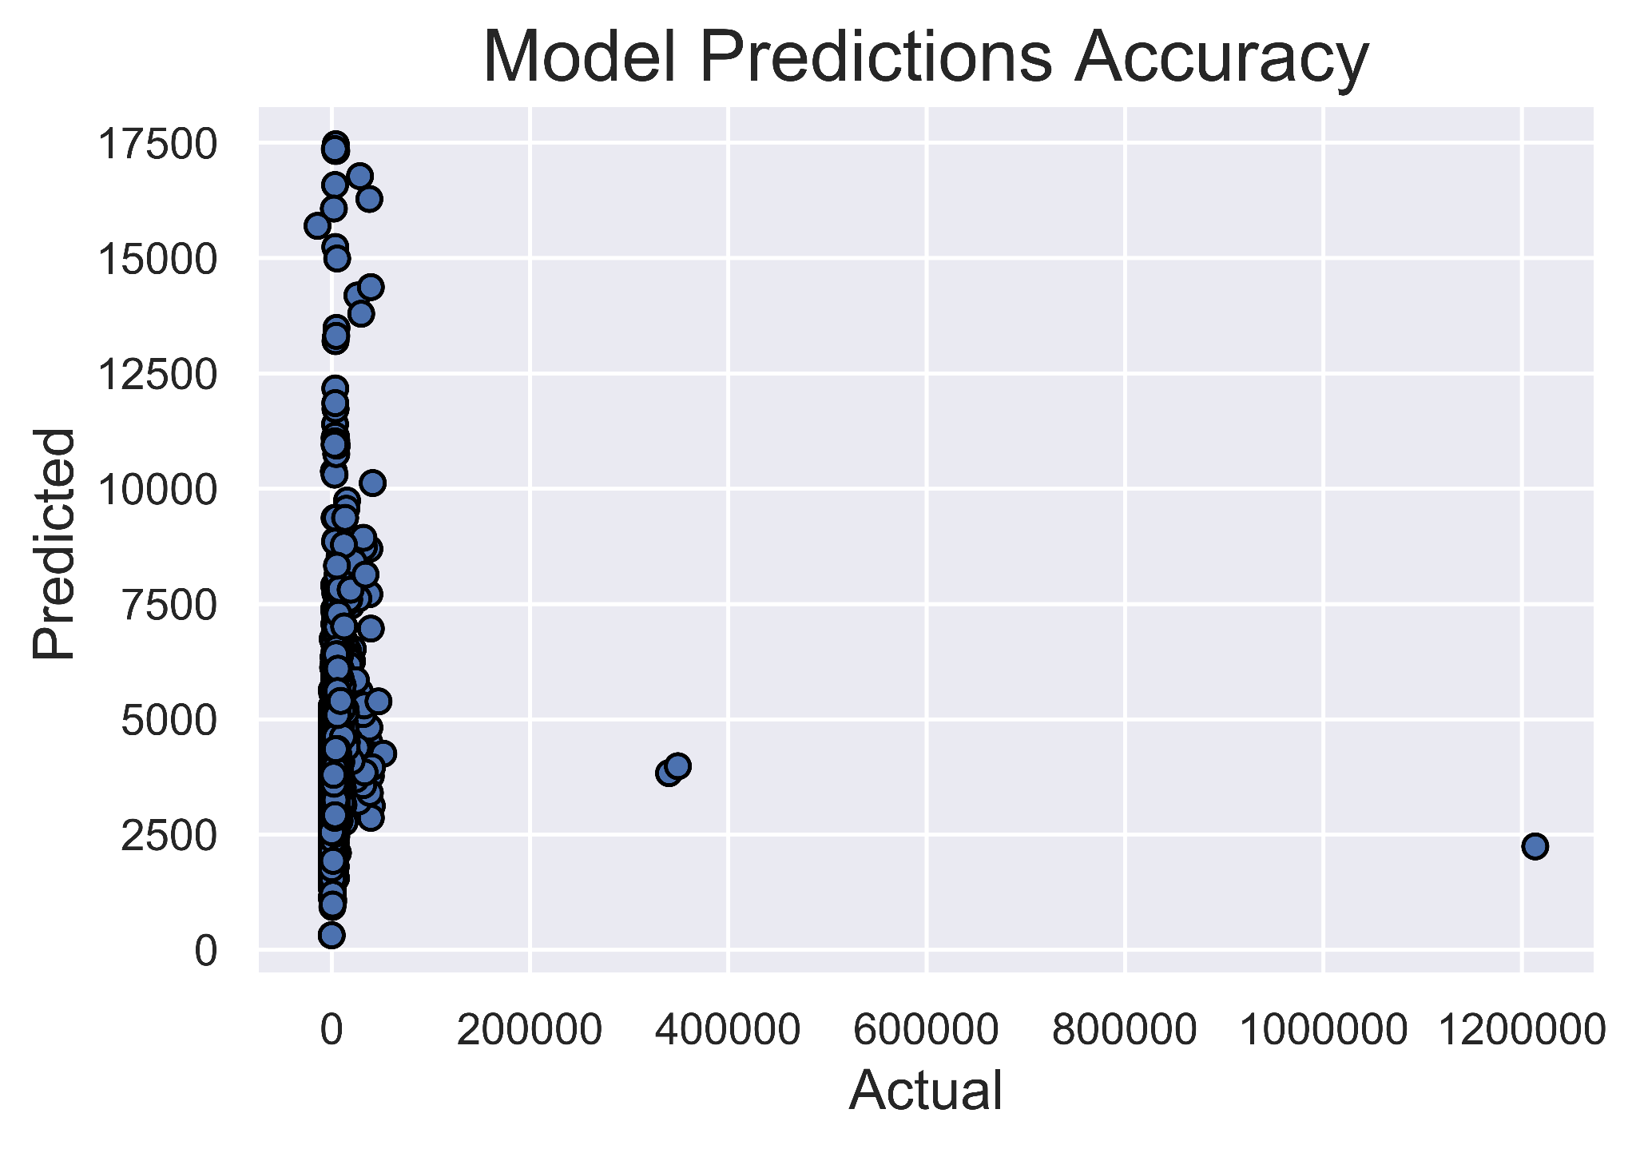
Model Performance
XGBoost Regressor | RMSE (million)
Training | 2.96
Test | 35.05
Notes:
After selecting a model to move forward with, I tested the XGBoost regressor on 20% of the training set that had been held out and got a root mean squared error of 2.96 million. For the true test, I fit the model on the full training set and then tested it on the original test set. This test had an RMSE of 35 million, which led me to suspect that there might be a few outliers throwing off the test score. Upon plotting the predicted values against the actual test values it became apparent that there were 3 outliers which caused the dramatic increase in error.

Slide 24
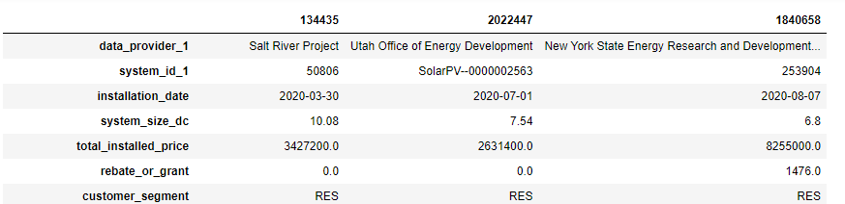
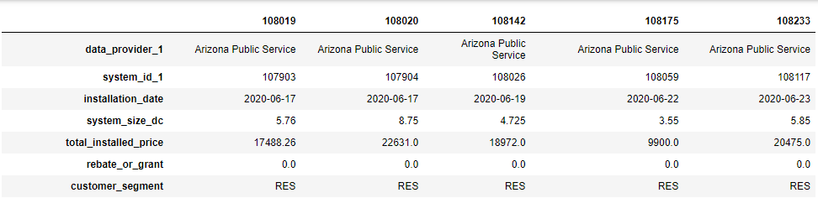
Outliers
Test without outliers:
2.40 million
Notes:
After identifying the outliers I pulled the original dataframe and compared those three outliers to five other random samples. The features that factor into the price per KW equation were system size DC, total installed price, and rebate or grant. The system sizes of the outliers are in line with the same general range as the random samples, and there weren’t unusual rebate or grant values, however, the total installed price was in the millions whereas the other samples ranged from 9 to 23 thousand. The two zeros at the end of each price also suggests that they could be a typo. When the outliers are removed the model RMSE drops to 2.40 million

Slide 25
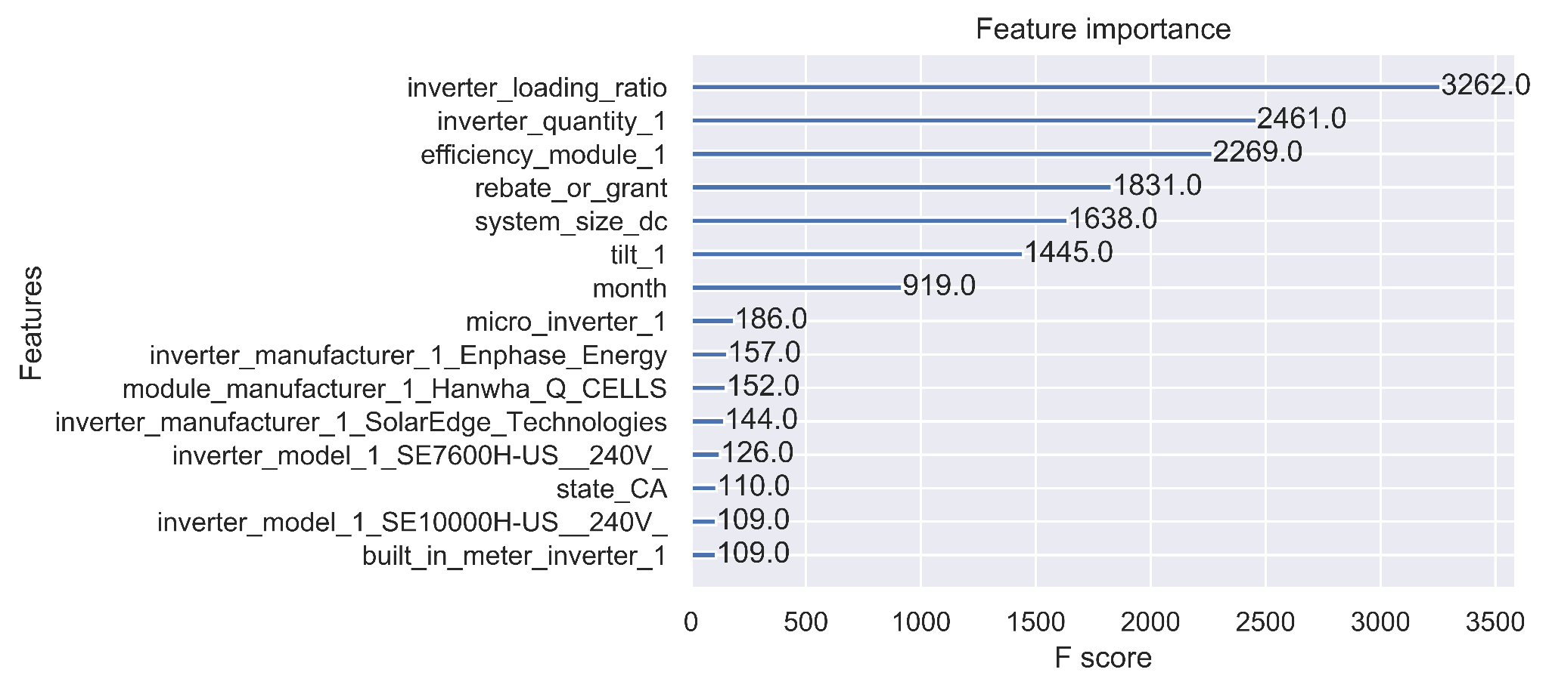
Most Important Features
Notes:
Considering that the outliers appeared to be typos, I proceeded to pull the top 15 most important features from my model.

Slide 26
Solar Panel Assembly
Inverter loading ratio
Inverter quantity
Photovoltaic module efficiency
Rebate or grant
System size
Tilt
Direct Current
Alternating Current
Notes:
So let’s run through how these system-related factors impact cost efficiency. First we’ll quickly mention rebate or grant. We’ve already seen how that factors into the cost efficiency equation. The larger the rebates or grants, the better your cost efficiency will be.

Slide 27
Solar Panel Assembly
Inverter loading ratio
Inverter quantity
Photovoltaic module efficiency
Rebate or grant
System size
Tilt
Direct Current
Alternating Current
Notes:
Next we’ll look at system size, which represents the amount of DC electricity output the solar panel array is rated for. As you would expect, as you add more capacity to the array, the added price decreases, similar to buying most other things in bulk.

Slide 28
Solar Panel Assembly
Inverter loading ratio
Inverter quantity
Photovoltaic module efficiency
Rebate or grant
System size
Tilt
Direct Current
Alternating Current
Notes:
While we’re discussing the solar panels we can talk about the conversion efficiency from sunlight to electricity. As you might expect, higher efficiency panels are more expensive than lower efficiency. If a customer is strictly concerned with installation costs, this is a straightforward decision. However, higher efficiency panels may make up for that added cost and make the customer more money in the long run as their system sells back excess electricity to the grid.

Slide 29
Solar Panel Assembly
Inverter loading ratio
Inverter quantity
Photovoltaic module efficiency
Rebate or grant
System size
Tilt
Direct Current
Alternating Current
Notes:
After the solar panels produce direct current electricity, the inverters turn that DC into alternating current which can be used by the grid. Much like with the solar panels, the more inverters you purchase, the lower the price per inverter will be.

Slide 30
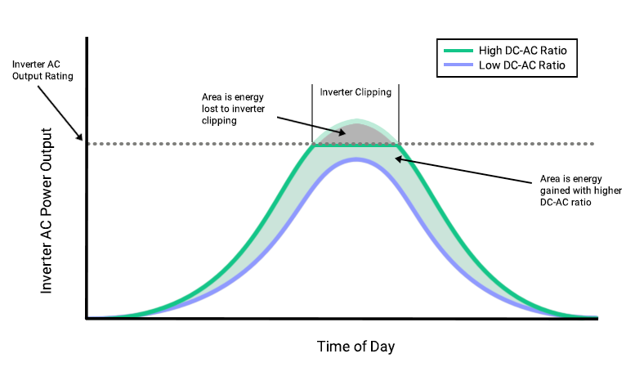
Solar Panel Assembly
Inverter loading ratio
Inverter quantity
Photovoltaic module efficiency
Rebate or grant
System size
Tilt
Direct Current
Alternating Current
Image source: https://aurorasolar.com/blog/choosing-the-right-size-inverter-for-your-solar-design-a-primer-on-inverter-clipping/
Notes:
Now I’ll get into the most important feature for the model: the inverter loading ratio. This refers to the maximum amount of DC electricity the panels can produce vs the amount of current that can be converted at peak by the inverters. If the inverter loading ratio was 1 and was scaled to the peak generation hours in the sunniest months of the year, you would limit the amount you can generate during all those off-peak hours, which make up the majority of the day. By increasing this ratio you capture and convert more sunlight during off-peak hours and only clip a relatively small amount during those peak hours when you can’t convert everything. By increasing this ratio you’re essentially not buying enough inverters to match the number of panels you have, which is where the savings comes in.

Slide 31
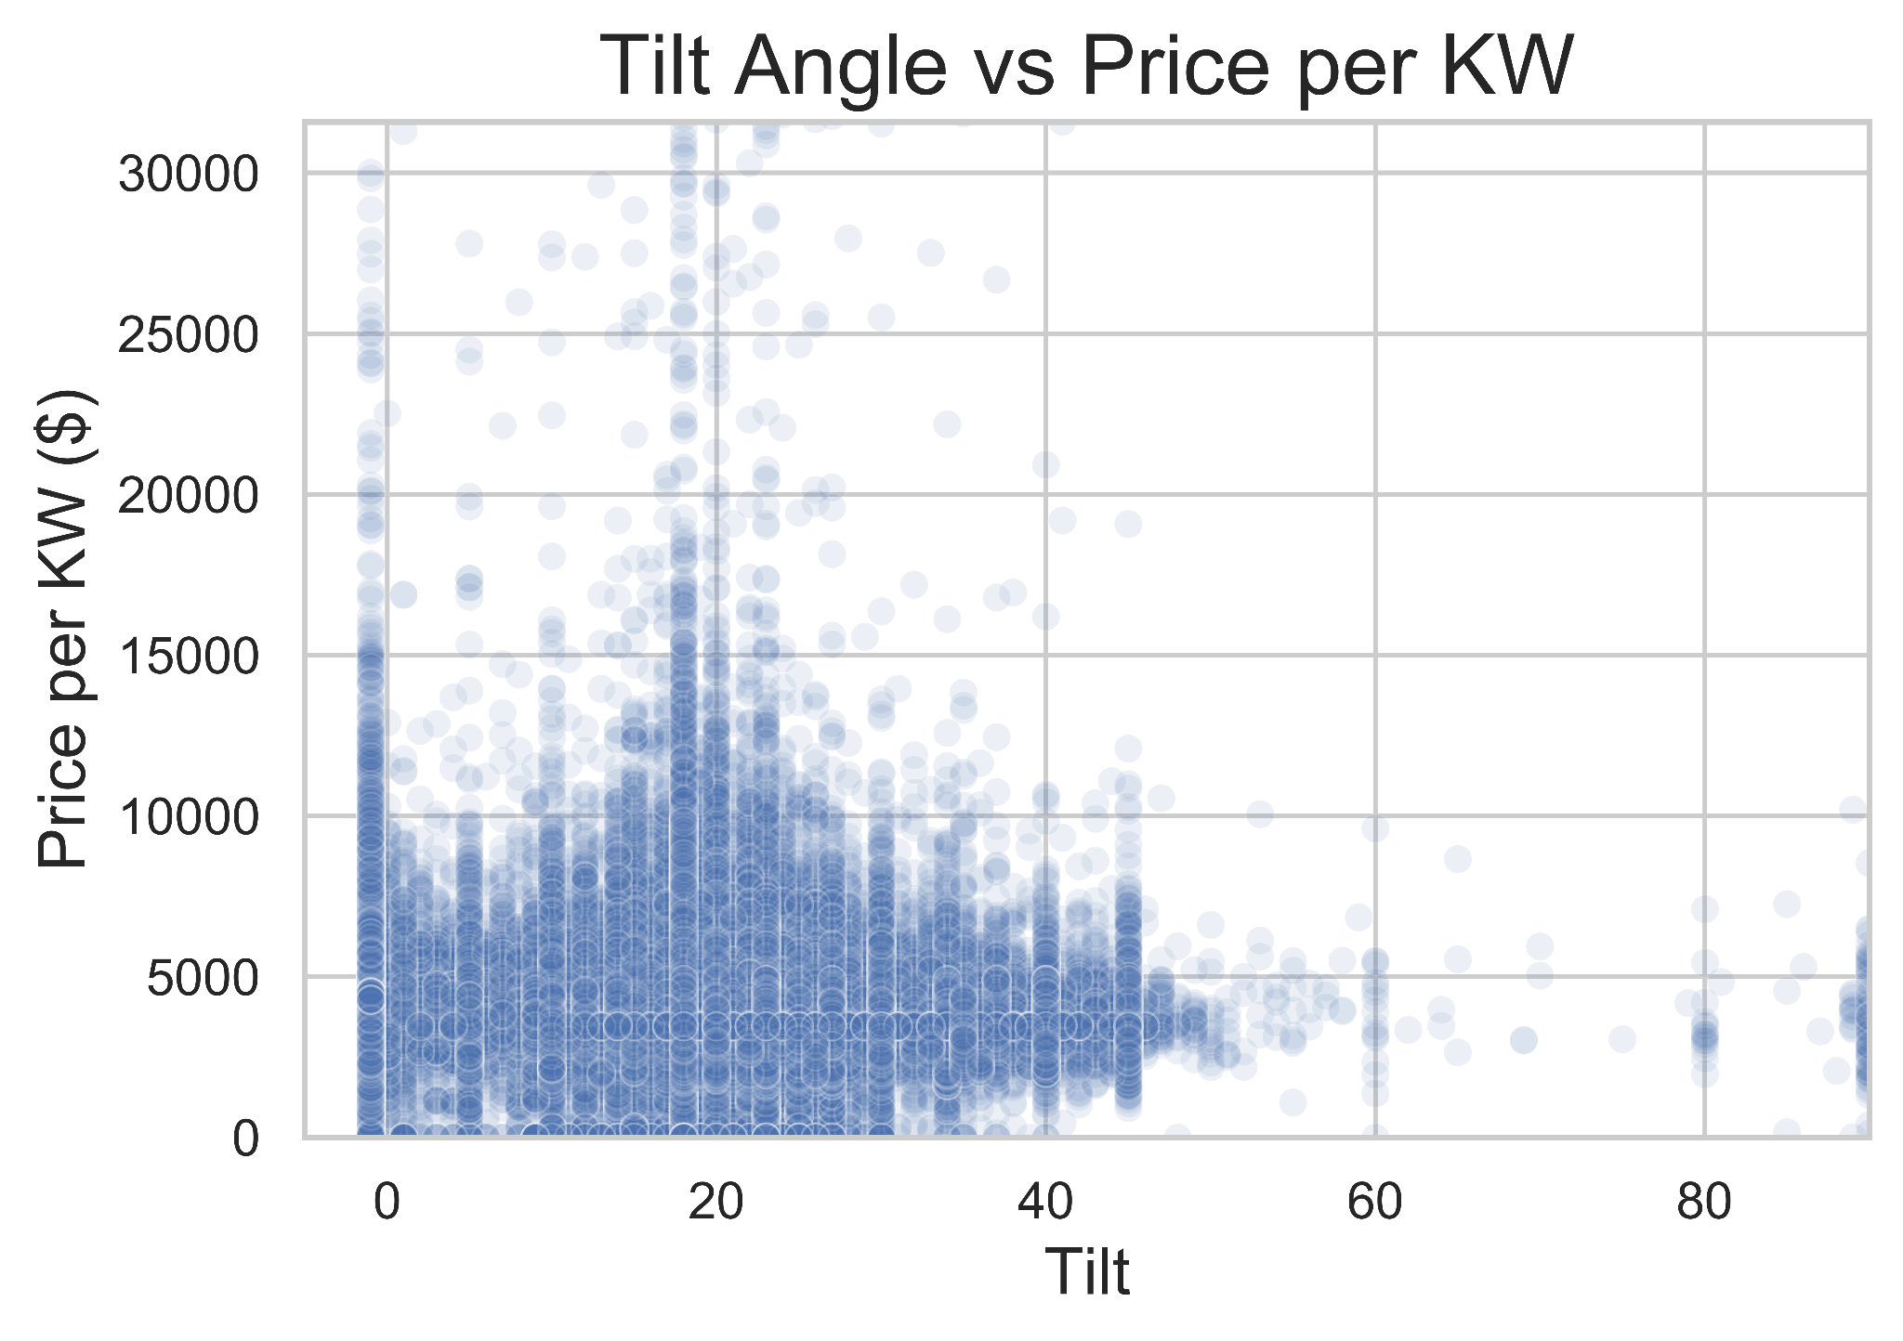
Tilt
Notes:
Tilt is a less clear picture. As you can see, there are certain angles with higher frequencies than others, seemingly multiples of 5. It seems unlikely that choosing to angle your array at 7 degrees rather than 10 would actually lower the cost of your installation. What I think is more likely is that there are more data points at some angles, and as you have more data points at a given angle, the chance of having expensive installations increases.

Slide 32
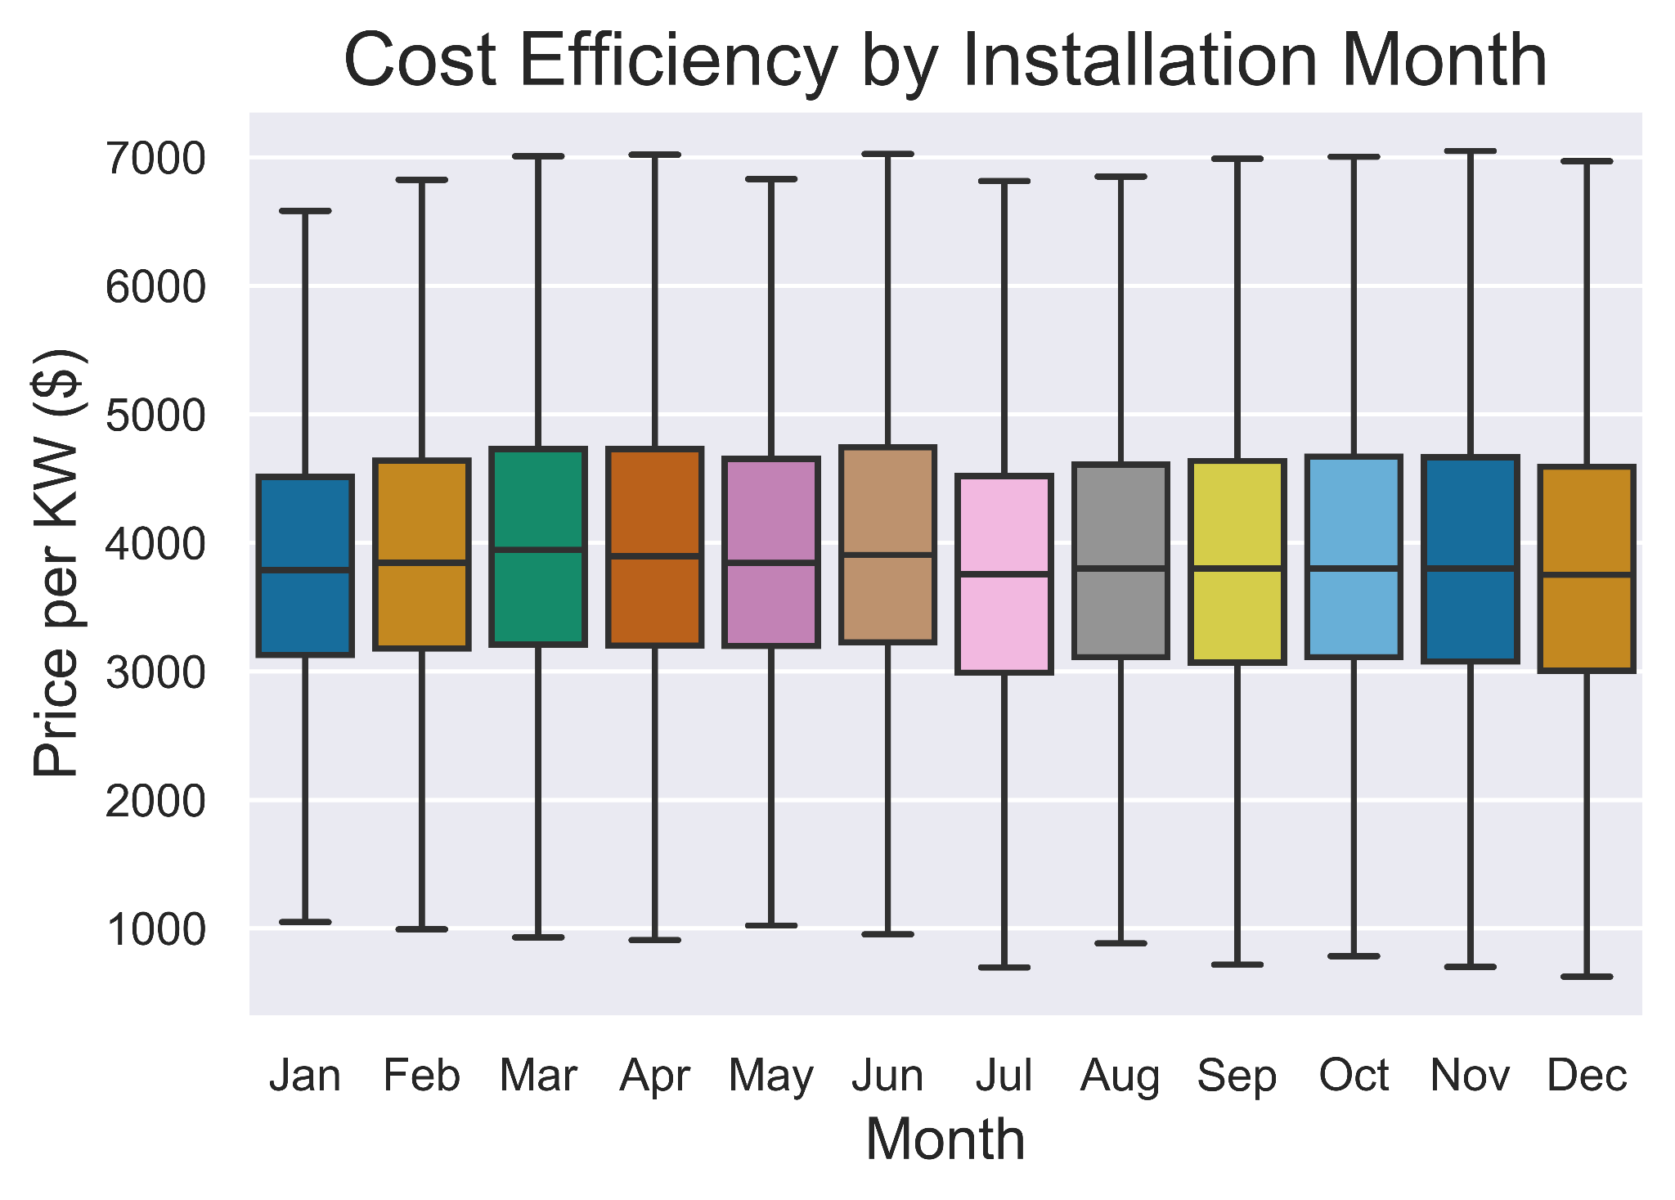
Installation Month
Notes:
Installation month is interesting in that there are certain months, July and December specifically, where the cost efficiency of an installation is better than the rest of the year. The distributions aren’t hugely different from month to month, but installations are significantly less in the second half of the year than the first half. It seems likely that prices rise early in the year prior to the peak sun months, then fall later in the year when the panels will generate less. It’s also possible that during July and December specifically there may be holiday pricing deals that don’t register as rebates or grants.

Slide 33
Summary
XGBoost regressor - 3M train RMSE, 35M test RMSE
Outliers likely due to typos in final installed price
Cost efficiency drivers:
Inverter loading ratio ↑ price per KW ↓
Inverter quantity ↑ price per KW ↓
PV module efficiency ↓ price per KW ↑
Rebate ↑ price per KW ↓
System Size ↑ price per KW ↓
Tilt
Month - July and December most efficient
Notes:
16

Slide 34
Future Work
Recommendation tool
Inputs:
Budget
Monthly electricity usage
Location/electrical supplier
Outputs:
System size
Inverter quantity
Available rebates/grants
Time to recover investment
Notes:
17

Slide 35
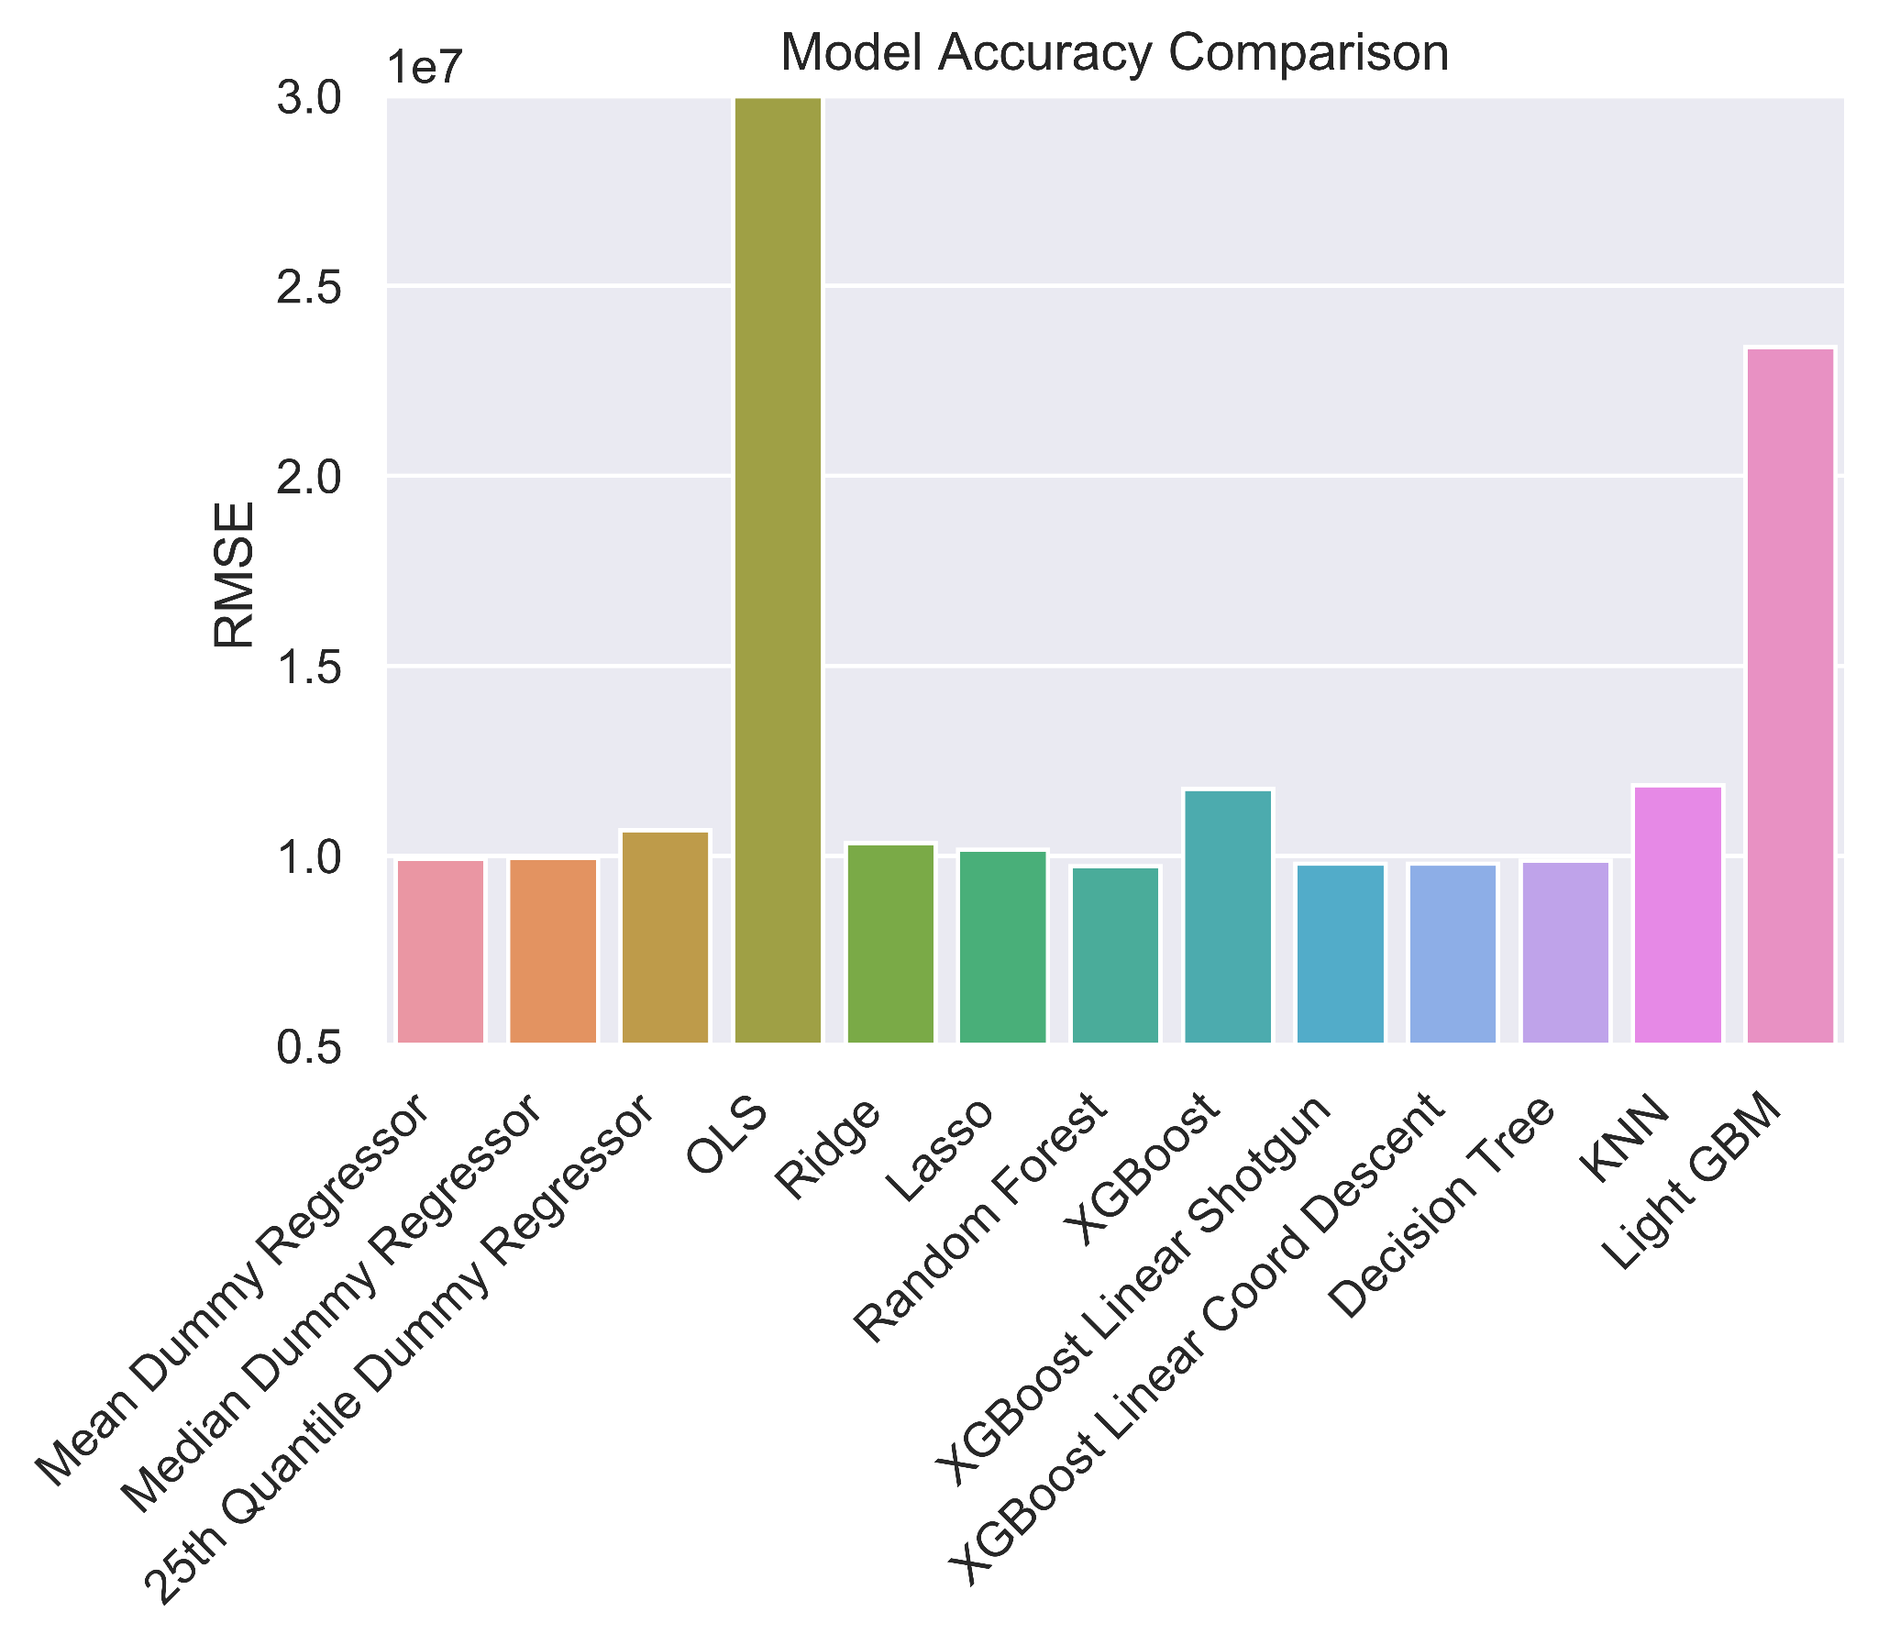
Appendix
Notes:
Initial performance after 10% train data hyperparameter tuning

Slide 36
Appendix
Model | Hyperparameters | RMSE
Mean Dummy Regressor | N/A | 9,923,409
Median Dummy Regressor | N/A | 9,941,871
25th Quantile Dummy Regressor | N/A | 10,670,605
Ordinary Least Squares | N/A | 1.2650560e+19
Ridge Regression | alpha | 10,327,496
Lasso Regression | alpha | 10,155,465
Random Forest Regression | max_features, max_depth, min_samples_leaf, n_estimators | 9,720,312
XGBoost Regressor | n_estimators, max_depth, eta, colsample_bytree | 11,759,799
Linear XGBoost Regressor - shotgun updater | reg_lambda, reg_alpha, feature_selector | 9,788,061
Linear XGBoost Regressor - coordinate descent updater | reg_lambda, reg_alpha, feature_selector | 9,789,561
Decision Tree Regressor | max_depth, min_samples_leaf | 9,865,568
K Nearest Neighbors Regressor | n_neighbors | 11,856,353
Light GBM Regressor | num_leaves, n_estimators, max_depth, learning_rate | 23,385,497
Notes:
Hyperparameters tuned

Slide 37
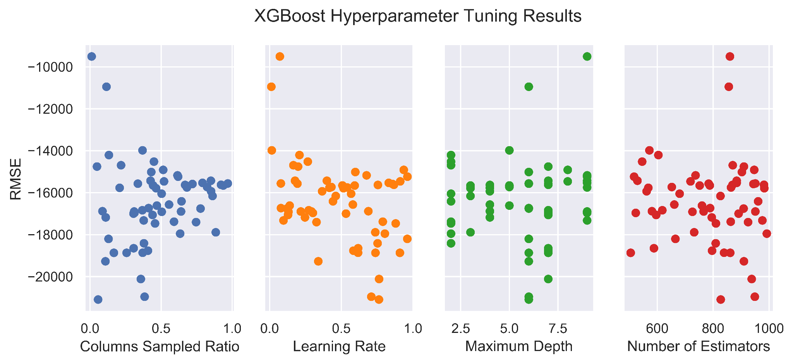
Appendix

Slide 38
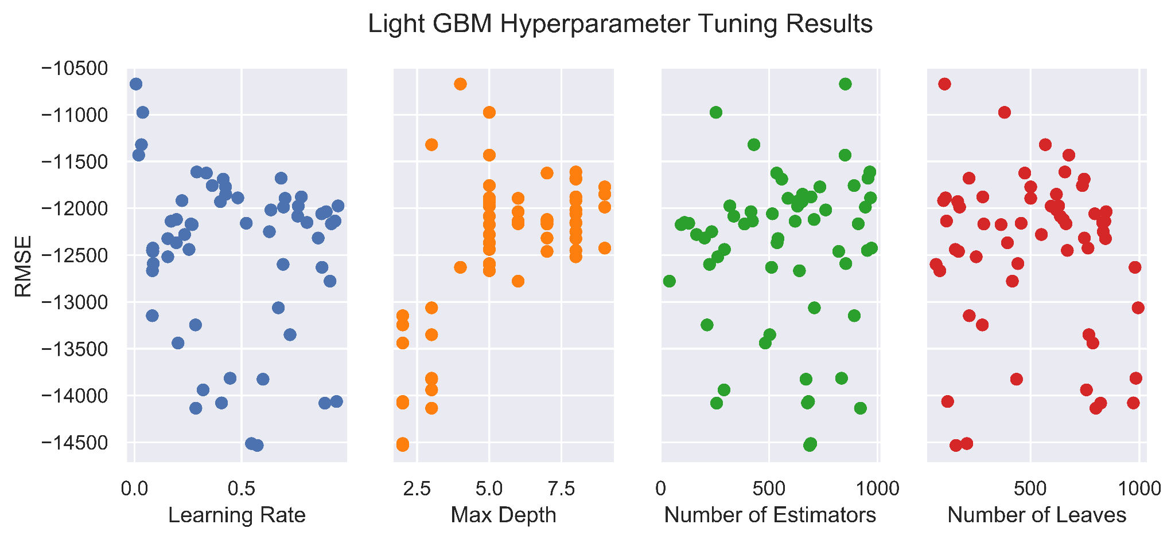
Appendix

